Slide 1
Software Engineering
Lecture-5

Slide 2
Unified Process (UP)
The Unified Software Development Process or Unified Process is a popular iterative and incremental software development process framework.
The Unified Process is
  Iterative and incremental
  Use case driven
  Architecture-centric
  Risk-focussed

Slide 3
UP (Iterative & Incremental)
The Unified Process is an iterative and incremental development process.
A series of timeboxed iterations.
Each iteration results in an increment, which is a release of the system that contains added or improved functionality compared with the previous release.
Although most iterations will include work in most of the process disciplines (e.g. Requirements, Design, Implementation, Testing), the relative effort and emphasis will change over the course of the project.

Slide 4
UP (Use case –driven)
In the Unified Process, use cases are used to capture the functional requirements and to define the contents of the iterations.
Each iteration takes a set of use cases or scenarios from requirements all the way through implementation, test and deployment.

Slide 5
UP (Architecture-centric)
The Unified Process insists that architecture sits at the heart of the project team's efforts to shape the system.
Since no single model is sufficient to cover all aspects of a system, the UP supports multiple architectural models and views.
One of the most important deliverables of the process is the executable architecture baseline which is created during the Elaboration phase.
This partial implementation of the system serves to validate the architecture and act as a foundation for remaining development.

Slide 6
UP (Risk-focussed)
The Unified Process requires the project team to focus on addressing the most critical risks early in the project life cycle.
The deliverables of each iteration, especially in the Elaboration phase, must be selected in order to ensure that the greatest risks are addressed first.

Slide 7
UP Phases
Inception:
  Business rationale, scope, identify risks, estimates
Elaboration:
  Requirements, high-level analysis and design of baseline architecture, construction plan, risk management.
Construction:
  Implement system features
    iteration 1: use cases A,B,C implemented
    iteration 2: use cases D,E implemented
    ...
Transition:
  Deployment, Beta testing, performance tuning, user training.

Slide 8
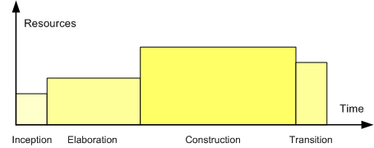
Relative size of the phases

Slide 9
Refinements & Variations
Refinements of the UP vary from each other in how they categorize the project disciplines or workflows, how different project artifacts are emphasized, how the phases after Transition are specified.
Organizations utilizing the UP invariably incorporate their own modifications and extensions.
  Agile Unified Process (AUP)
  Basic Unified Process (BUP)
  Enterprise Unified Process (EUP)
  Essential Unified Process (EssUP)
  Open Unified Process (OpenUP)
  Rational Unified Process (RUP)
  Oracle Unified Method (OUM)

Slide 10
RUP (Rational Unified Process)
The best-known and extensively documented refinement of the Unified Process is the Rational Unified Process or RUP.
IBM Rational Unified Process (RUP) is a comprehensive process framework that provides proven best practices for software and systems delivery and implementation and effective project management.

Slide 11
RUP
It provides a disciplined approach to assigning tasks and responsibilities within a development organization.
Its goal is to ensure the production of high-quality software that meets the needs of its end-users, within a predictable schedule and budget.
RUP enhances team productivity, by providing every team member with easy access to a knowledge base with guidelines, templates and tool mentors for all critical development activities.
By having all team members accessing the same knowledge base, no matter if you work with requirements, design, test, project management, or configuration management, we ensure that all team members share a common language, process and view of how to develop software.

Slide 12
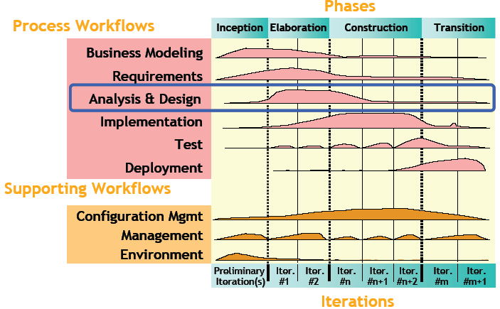

Slide 13
Workflows / Disciplines
Business modelling
  Domain object modeling,
Requirements
  Writing use cases, identifying non functional requirements
Analysis & Design
  overall architecture, objects, databases, networking
Implementation
  Programming the system
Test
  Verification of system interactions
Deployment
  Product releases, installation, delivery
Configuration Management
  managing multiple variants of evolving software systems, tracking which versions are used in given software builds, enforcing policies.
Environment
  Establishing the tools and customizing the process for the project, setting up the tool and process environment

Slide 14
Features
The RUP activities create and maintain models.
Rather than focusing on the production of large amount of paper documents, the Unified Process emphasizes the development and maintenance of models—semantically rich representations of the software system under development.
The Rational Unified Process is supported by tools, which automate large parts of the process.
They are used to create and maintain the various artifacts—models in particular—of the software engineering process: visual modeling, programming, testing, etc.

Slide 15
Best Practices
RUP captures many of the best practices in modern software development in a form that is suitable for a wide range of projects and organizations.
Deploying these best practices using the RUP as your guide offers development teams a number of key advantages.
  Develop software iteratively
  Manage requirements
  Use component-based architectures
  Visually model software
  Verify software quality
  Control changes to software

Slide 16
Inception
to do just enough investigation to form a rational, justifiable opinion of the overall purpose and feasibility of the potential new system, and decide if it is worthwhile to invest in deeper exploration
It is to decide if the project is worth a serious investigation (during elaboration), not to do that investigation.

Slide 17
Inception
the purpose of the inception phase is
  not to define all the requirements, or generate a believable estimate or project plan.
  Envision the product scope, vision, and business case.

Slide 18
Inception
Artifacts that start in inception phase
Artifact[] | Comment
Vision and Business Case | Describes the high-level goals and constraints, the business case, and provides an executive summary.
Use-Case Model | Describes the functional requirements. During inception, the names of most use cases will be identified, and perhaps 10% of the use cases will be analyzed in detail.
Supplementary Specification | Describes other requirements, mostly non-functional. During inception, it is useful to have some idea of the key non-functional requirements that have will have a major impact on the architecture.
Glossary | Key domain terminology, and data dictionary.
Risk List & Risk Management Plan | Describes the risks (business, technical, resource, schedule) and ideas for their mitigation or response.
Prototypes and proof-of-concepts | To clarify the vision, and validate technical ideas.
Iteration Plan | Describes what to do in the first elaboration iteration.
Phase Plan & Software Development Plan | Low-precision guess for elaboration phase duration and effort. Tools, people, education, and other resources.
Development Case | A description of the customized UP steps and artifacts for this project. In the UP, one always customizes it for the project.

Slide 19
Inception
These artifacts are only partially completed in this phase. They will be iteratively refined in subsequent iterations
Artifacts should be considered optional. Choose to create only those that really add value for the project, and drop them if their worth is not proved.

Slide 20
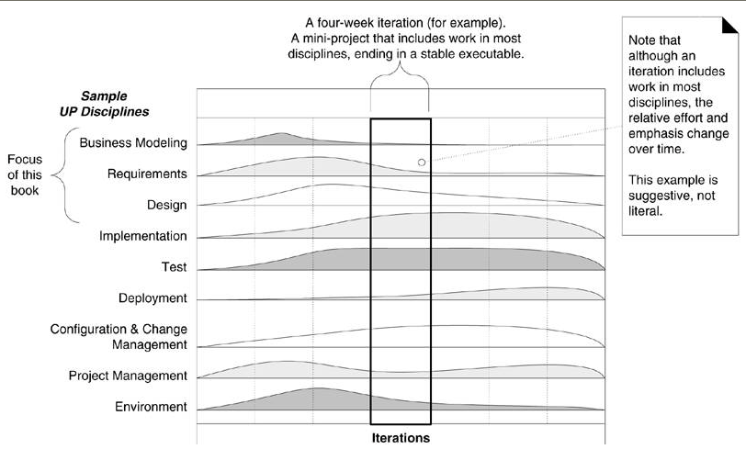

Slide 21
Software Project Planning
Software project management begins with a set of activities that are collectively called project planning.
The objective of software project planning is to provide a framework that enables the manager to make reasonable estimates of resources, cost, and schedule. These estimates are made within a limited time frame at the beginning of a software project and should be updated regularly as the project progresses.
Planning also include risk analysis change management activities

Slide 22
Estimation
It includes estimation of resources, cost and schedule
Following factors can effect project estimation
  Project Complexity
  Project Size
  degree of structural uncertainty

Slide 23
A Key Note
it is not always politically acceptable to modify initial estimates. A mature software organization and its managers recognize that change is not free. And yet, many customers demand (incorrectly) that an estimate once made must be maintained regardless of changing circumstances.

Slide 24
Project Scope
The first activity in software project planning is the determination of software scope.
Software scope describes the data and control to be processed, function, performance, constraints, interfaces, and reliability
Functions described in the statement of scope are evaluated and in some cases refined to provide more detail prior to the beginning of estimation

Slide 25
Defining Project Scope
A Q/A session between the company and customer may help to start the communication and help to define project scope.

Slide 26
Example Questions in Q/A Session
Who is behind the request for this work?
Who will use the solution?
What will be the economic benefit of a successful solution?
Is there another source for the solution?
How would you (the customer) characterize "good" output that would be generated by a successful solution?
What problem (s) will this solution address?
Can you show me (or describe) the environment in which the solution will be used?

Slide 27
Project Feasibility
Once scope has been identified (with the concurrence of the customer), it is reasonable to ask: “Can we build software to meet this scope?
software feasibility has four solid dimensions:
  Technology— Is a project technically feasible? Is it within the state of the art? Can defects be reduced to a level matching the application’s needs?
  Finance—Is it financially feasible? Can development be completed at a cost the software organization, its client, or the market can afford?
  Time—Will the project’s time-to-market beat the competition?
  Resources—Does the organization have the resources needed to succeed?

Slide 28
RESOURCES
Human Resources
  The number of people required for a software project can be determined only after an estimate of development effort (e.g., person-months) is made.
Reusable Software Resources
Environmental Resources

Slide 29
Reusable Software Resources
Off-the-shelf components. Existing software that can be acquired from a third party or that has been developed internally for a past project.
Full-experience components. Existing specifications, designs, code, or test data developed for past projects that are similar to the software to be built for the current project.

Slide 30
Reusable Software Resources
Partial-experience components. Existing specifications, designs, code, or test data developed for past projects that are related to the software to be built for the current project but will require substantial modification.
New components. Software components that must be built by the software team specifically for the needs of the current project.

Slide 31
Reusable Software Resources
If off-the-shelf components meet project requirements, acquire them. The cost for acquisition and integration of off-the-shelf components will almost always be less than the cost to develop equivalent software. In addition, risk is relatively low.
If full-experience components are available, the risks associated with modification and integration are generally acceptable. The project plan should reflect the use of these components.
If partial-experience components are available, their use for the current project must be analyzed. If extensive modification is required before the components can be properly integrated with other elements of the software, proceed carefully—risk is high. The cost to modify partial-experience components can sometimes be greater than the cost to develop new components.

Slide 32
Environmental Resources
The environment that supports the software project, often called the software engineering environment (SEE), incorporates hardware and software

Slide 33
Software Project Estimation
To achieve reliable cost and effort estimates, a number of options arise:
Delay estimation until late in the project (obviously, we can achieve 100% accurate estimates after the project is complete!).
Base estimates on similar projects that have already been completed.
Use relatively simple decomposition techniques to generate project cost and effort estimates.
Use one or more empirical models for software cost and effort estimation.

